Slide 1


Classification: setup, training/test split, overfitting
Session No.: 07
Course Name: Machine Learning
Course Code: R1UC525B
Instructor Name: Dr. Sivakumar Madeshwaran
Duration: 50 Minutes
Date of Conduction of Class: 08-09-2026

Slide 2

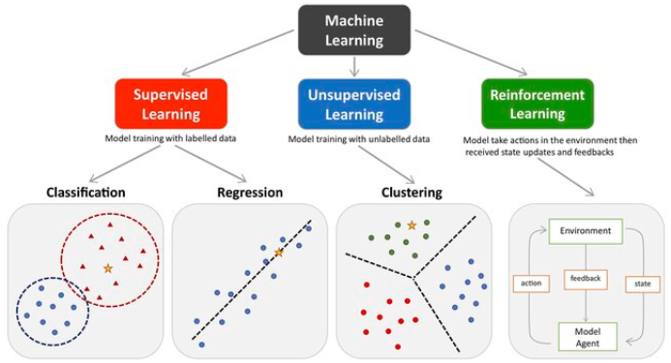
Recap of Previous Lecture
Supervised → Labelled data
(Prediction: Regression / Classification)
Unsupervised → Unlabelled data
(Clustering, Dimensionality reduction)
Reinforcement → Agent + Environment + Rewards

Slide 3
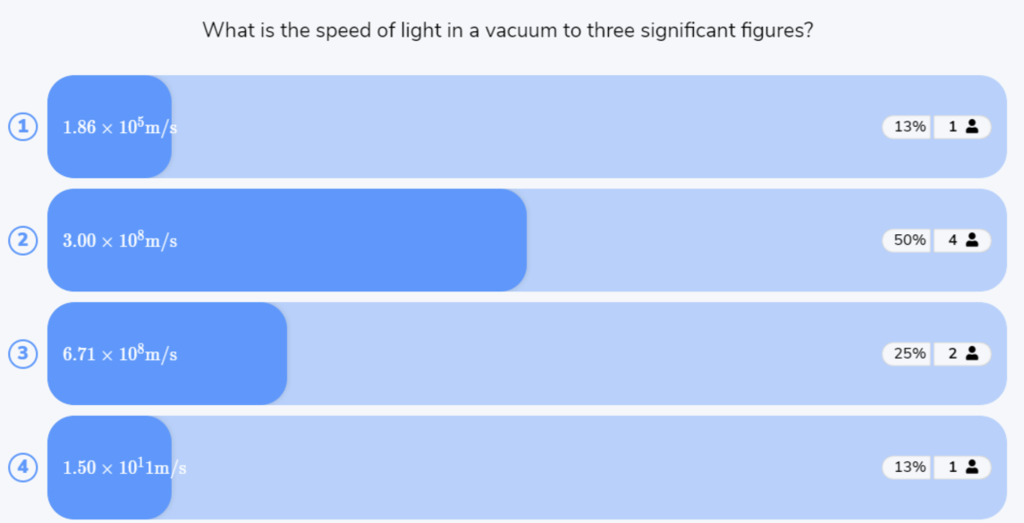
Reflect on the responses of post session activity

Slide 4



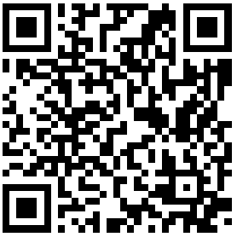
“Why do we divide a dataset into training and testing data when building a classification model?”
Opening Question

Slide 5
Answer:
We use the training data to teach the classification model and the test data to evaluate how well it predicts unseen data. This helps identify overfitting, where a model performs well on training data but poorly on new data.
Opening Question -Reflections

Slide 6
At the end of this session students will be able to
LO1: Explain the basic setup of a classification problem and differentiate between training and testing datasets.
LO2: Identify and explain overfitting in classification models and apply appropriate techniques to improve model generalization.

Slide 7
Session Outline
1 Introduction to Classification and its types
2 Activity-1 (Think –Pair -Share)
3 Training/Test Split
4 Activity-2 (Quiz on Wooflash)
5 Review and Reflections

Slide 8
Introduction to Classification
Definition :
Classification is a supervised learning task in machine learning where the goal is to predict the categorical class labels of new instances based on past observations.
OR
Classification is a supervised learning task in machine learning where the model learns from labeled training data to categorize new, unseen data into predefined classes (categories).
Goal: Predict a discrete output (class label) given an input.

Slide 9
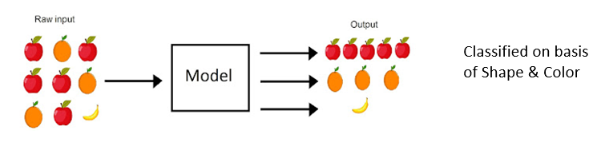
Introduction to Classification
Supervised Machine learning is a branch of artificial intelligence that focuses in training models to make predictions or decisions based on labelled training data.
How you classify the Raw Input ?

Slide 10
Introduction to Classification
Definition: Predicting discrete class labels based on input features.
Input (X): Features → e.g., weight, color, shape of fruit.
Output (Y): Classes → e.g., Apple, Banana, Mango.
Goal: Learn a mapping function f : X → Y
Visual Suggestion:
Dataset (fruit features) → ML model → Predicted Class.
A classifier in machine learning is an algorithm or model that categorizes input data into predefined classes or labels. In simple terms, it’s used for classification tasks — deciding "which category does this data point belong to?"

Slide 11
Basic Steps for Classification
Step 1 : Data Collection & Data Pre-processing
Step 2: Training : In training phase, where the classification technique constructs the model by learning from a given training data set accompanied by their related class label attributes.
Step 3 : Testing : It estimates the performance of the derived model using the test data set.

Slide 12
Types of Classification Problems
Binary Classification: Represented as “positive” and “negative” or “1” and “0”
Example : disease present or absent, Yes/No, Spam/Not Spam.
Multi-class Classification: Handwritten digits (0–9), Sentiment analysis (positive, negative, neutral), and image classification (various object categories).
Example: when there are more than two categories or classes involved, like grading students based on their marks (e.g., A, B, C, D, F), it becomes an example of a multi-classification problem.
Multi-label Classification: Each instance can belong to multiple classes simultaneously.
Example : A movie can be both Comedy + Romance, news article may belong to multiple categories such as “politics,” “sports,” and “technology” simultaneously.

Slide 13
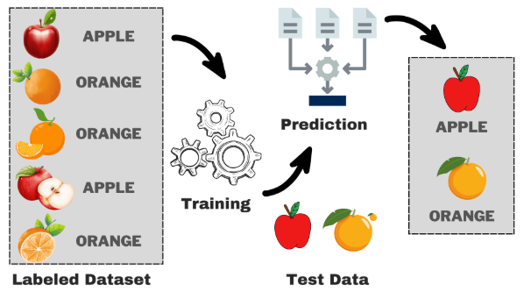
Working Principle of Classification

Slide 14
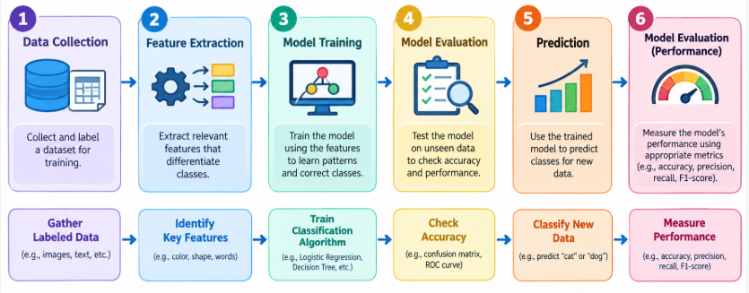
Working Principle of Classification

Slide 15
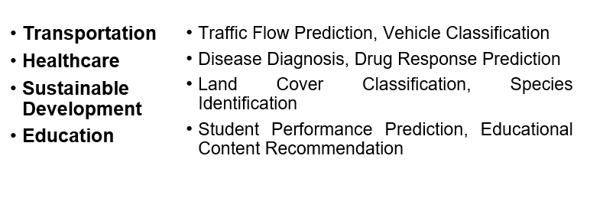
Learning Activity-1: Think-pair-share
Explain how in given scenario Machine Learning is classified?

Slide 16
Learning Activity-1: Think-pair-share
Explain how in given scenario Machine Learning is classified?
Reflection of
Learning Activity-1

Slide 17
Measure the efficiency of a Classification model (Training/test split)
Training and Testing Split: It is the splitting of a dataset into multiple parts. We train our model using one part and test its effectiveness on another.
Data splitting is the process of splitting data into 3 sets:
  Training set : Data which we use to design our models.
  Validation set : Data which we use to refine our models.
  Testing set : Data which we use to test our models.
  If we do not split our data, we might test our model with the same data that we use to train our model.
Example
  If the model is a trading strategy specifically designed for Apple stock in 2008, and we test its effectiveness on Apple stock in 2008, of course it is going to do well.
  We need to test it on 2009’s data. Thus, 2008 is our training set and 2009 is our testing set.

Slide 18
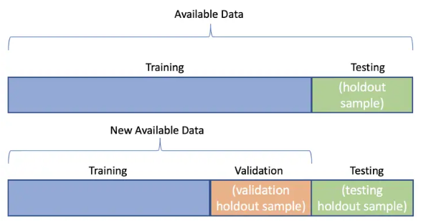
Measure the efficiency of a Classification model (Training/test split)
Data Splitting in Modelling

Slide 19
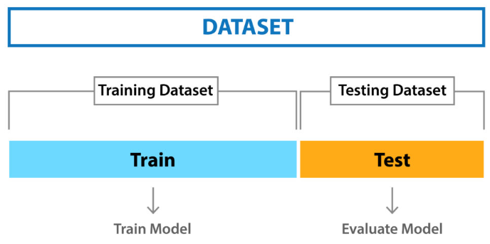
Measure the efficiency of a Classification model (Training/test split)
1. Holdout Method: The holdout method involves splitting the dataset into a training set and a test set, training the model on the training set, and evaluating it on the test set.

Slide 20
Measure the efficiency of a Classification model (Training/test split)
2. Cross-Validation: Cross-validation is a technique used to assess the generalization performance of a model by splitting the dataset into multiple subsets, training the model on a subset, and evaluating it on the remaining subsets.
With this technique, the data set is randomly divided into k equal-sized, mutually exclusive subsets.
One is retained for testing, while the others are utilized for training the model. For each of the k folds, the same procedure is followed.

Slide 21
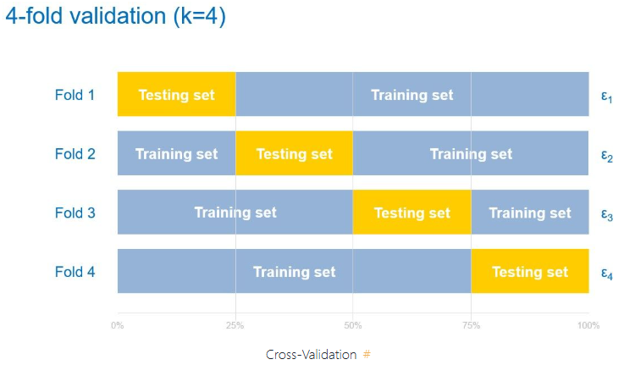
Measure the efficiency of a Classification model (Training/test split)

Slide 22
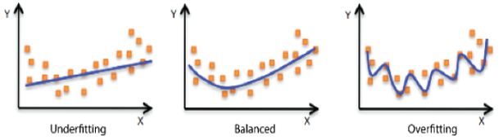
Why Training/test split is important
Checks real-world performance – Can the model work on new data?
Detects overfitting – Prevents us from believing a model is good just because it memorized the training data.
Provides an unbiased evaluation – The test data acts like a final exam.
Helps compare models – We can compare different algorithms using the same test data.

Slide 23
Challenges in Classification
Overfitting → Model performs well on training data but poorly on unseen data.
Imbalanced Data → Class imbalance skews predictions toward majority class.
High-Dimensional Data → Too many features can cause complexity (curse of dimensionality).
Noise & Outliers → Incorrect labels or unusual data can mislead models.

Slide 24
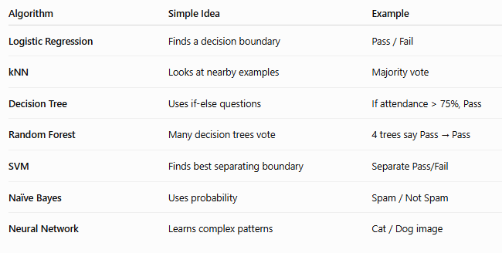
Common Classification Algorithms

Slide 25
Critical Question
If your model has 99% training accuracy but only 60% test accuracy, what does this mean and what would you do?

Slide 26
Answer of Critical Question
99% Training Accuracy → The model learned the training data extremely well. 60% Test Accuracy → But it fails to generalize to unseen data.
Meaning: The model is overfitting. It has memorized patterns (and possibly noise) in the training set rather than learning generalizable rules.

Slide 27

Activity 2: Rapid Quiz

Slide 28
Summary
Classification is a supervised learning task where models predict categorical outputs based on input features.
Types include Binary, Multi-class, and Multi-label Classification.
Training–testing split is essential for evaluating model performance and avoiding bias.
Overfitting & Underfitting are major challenges — models must balance complexity and generalization.
Different algorithms (Logistic Regression, kNN, Decision Trees, Random Forest, SVM, Naïve Bayes, Neural Networks) are used depending on the problem.
Conclusion: A well-designed classification model helps in accurate decision-making, but proper evaluation and control of overfitting/underfitting are key to reliable performance.

Slide 29
Ensure attainment of LOs in alignment to the learning activities: outcomes (1-2)
LO1: Explain the basic setup of a classification problem and differentiate between training and testing datasets.
LO2: Identify and explain overfitting in classification models and apply appropriate techniques to improve model generalization.

Slide 30
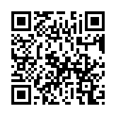
Post Session Activity

Slide 31
Information about the next lesson
Supervised Learning: regression and classification problems, Simple Linear Regression

Slide 32


Review and Reflection from students

